Slide 1
Ford Fulkerson Algorithm for maximum flow

Slide 2
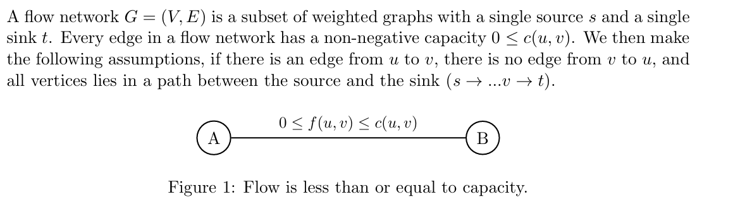
Max Flow

Slide 3
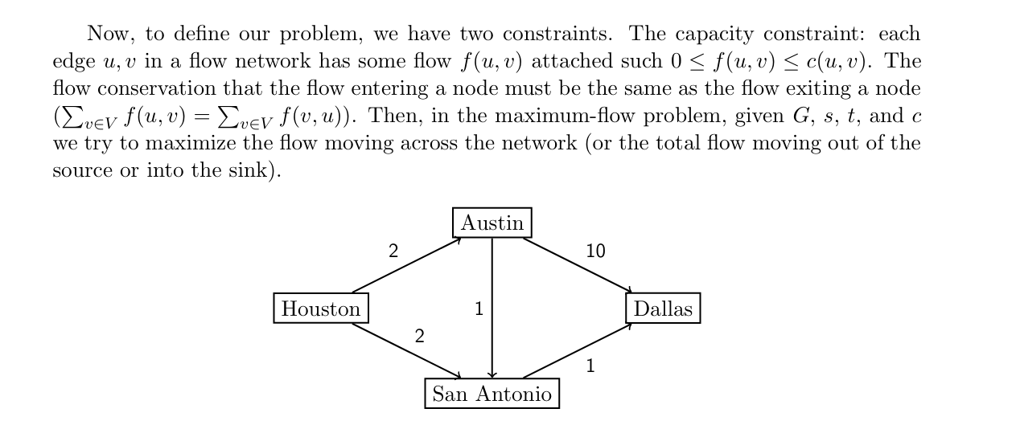

Slide 4
Max-Flow Min-Cut Theorem says:
In any flow network, the maximum possible flow from source s to sink t is exactly equal to the minimum capacity of an s–t cut.
So two things are secretly the same number:
Max flow = most water you can push from s → t
Min cut = cheapest “set of edges to cut” so s can’t reach t anymore

Slide 5
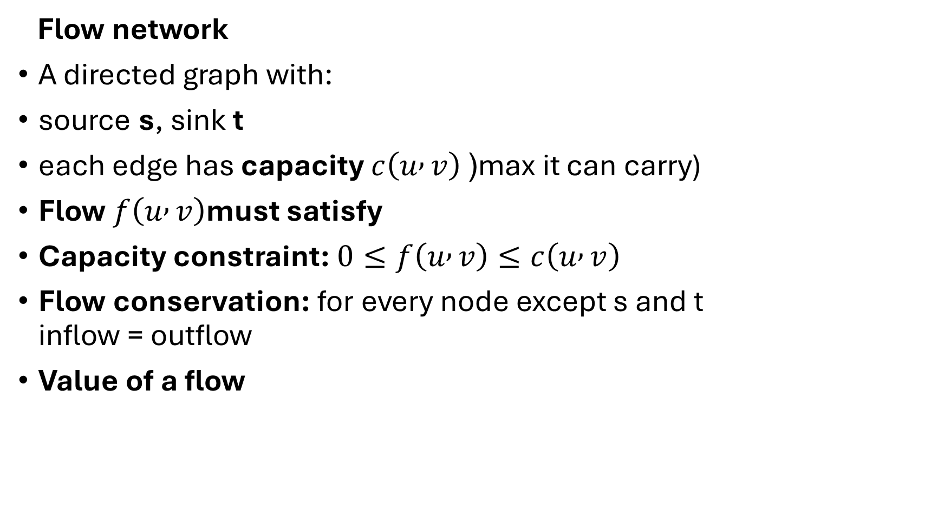
Flow network
A directed graph with:
source s, sink t
each edge has capacity $c\left(u , v\right)$ (max it can carry)
Flow $f\left(u , v\right)$must satisfy
Capacity constraint: $0≤f\left(u , v\right)≤c\left(u , v\right)$
Flow conservation: for every node except s and t inflow = outflow
Value of a flow

Slide 6
Ford –Fulkerson Algorithm
The Ford-Fulkerson algorithm is a widely used algorithm to solve the maximum flow problem in a flow network.
The maximum flow problem involves determining the maximum amount of flow that can be sent from a source vertex to a sink vertex in a directed weighted graph, subject to capacity constraints on the edges.
The algorithm works by iteratively finding an augmenting path, which is a path from the source to the sink in the residual graph.
Residual graph obtained by subtracting the current flow from the capacity of each edge.
The algorithm then increases the flow along this path by the maximum possible amount, which is the minimum capacity of the edges along the path.

Slide 7
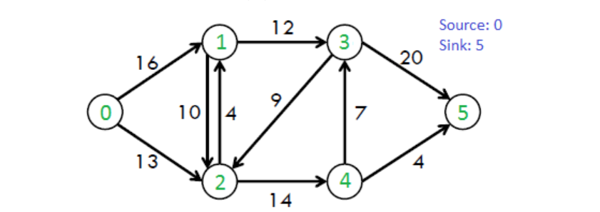
The algorithm works on residual graph
Residual graph changes after every augmenting path.

Slide 8

Solving this problem step by step using the algorithm.
Capacities
$0→1:16$, $0→2:13$
$1→2:10$, $2→1:4$
$1→3:12$, $3→2:9$
$2→4:14$, $4→3:7$
$3→5:20$, $4→5:4$

Slide 9
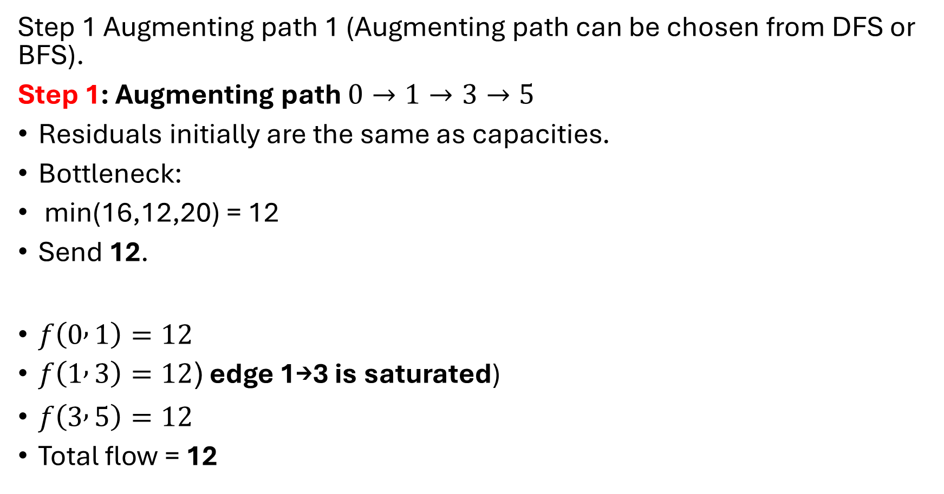
Step 1 Augmenting path 1 (Augmenting path can be chosen from DFS or BFS).
Step 1: Augmenting path $0→1→3→5$
Residuals initially are the same as capacities.
Bottleneck:
min(16,12,20) = 12
Send 12.
$f\left(0 , 1\right)=12$
$f\left(1 , 3\right)=12$( edge 1→3 is saturated)
$f\left(3 , 5\right)=12$
Total flow = 12

Slide 10
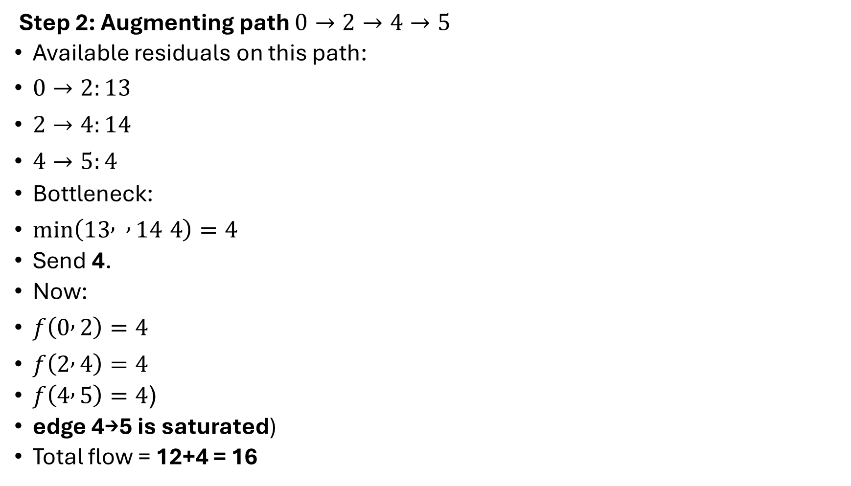
Step 2: Augmenting path $0→2→4→5$
Available residuals on this path:
$0→2:13$
$2→4:14$
$4→5:4$
Bottleneck:
$min⁡\left(13 , , 14 4\right)=4$
Send 4.
Now:
$f\left(0 , 2\right)=4$
$f\left(2 , 4\right)=4$
$f\left(4 , 5\right)=4$(
edge 4→5 is saturated)
Total flow = 12+4 = 16

Slide 11
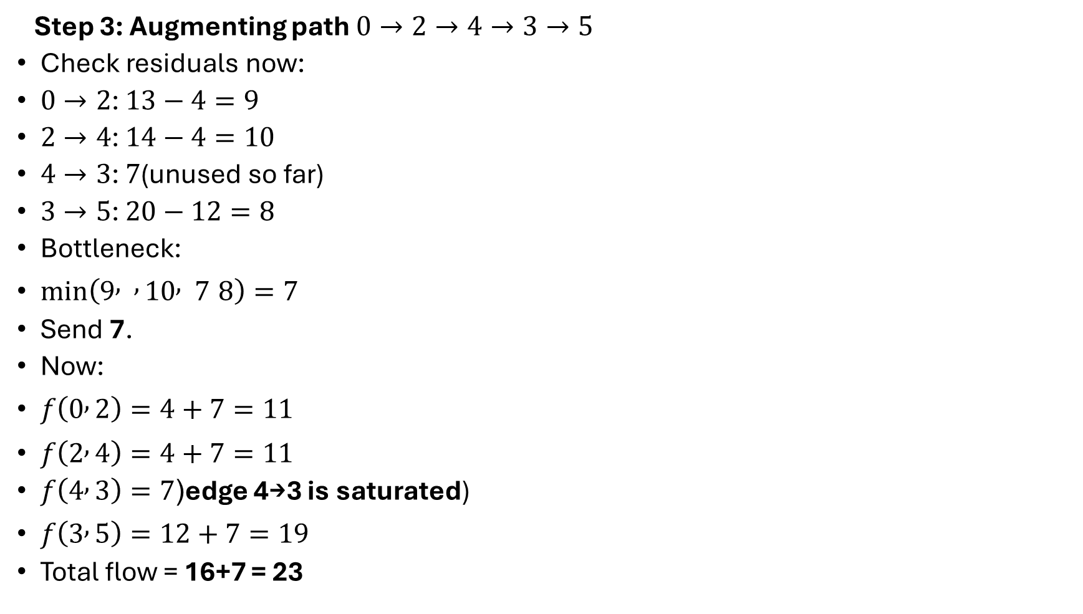
Step 3: Augmenting path $0→2→4→3→5$
Check residuals now:
$0→2$: $13−4=9$
$2→4$: $14−4=10$
$4→3$: $7$(unused so far)
$3→5$: $20−12=8$
Bottleneck:
$min⁡\left(9 , , 10 , 7 8\right)=7$
Send 7.
Now:
$f\left(0 , 2\right)=4+7=11$
$f\left(2 , 4\right)=4+7=11$
$f\left(4 , 3\right)=7$(edge 4→3 is saturated)
$f\left(3 , 5\right)=12+7=19$
Total flow = 16+7 = 23

Slide 12
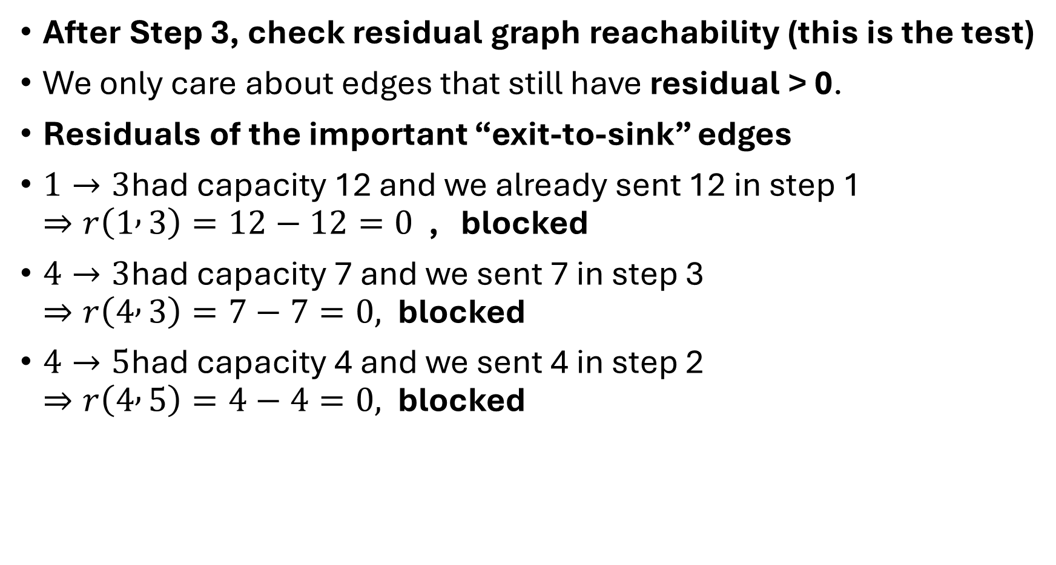
After Step 3, check residual graph reachability (this is the test)
We only care about edges that still have residual > 0.
Residuals of the important “exit-to-sink” edges
$1→3$had capacity 12 and we already sent 12 in step 1 $⇒r\left(1 , 3\right)=12−12=0$ , blocked
$4→3$had capacity 7 and we sent 7 in step 3 $⇒r\left(4 , 3\right)=7−7=0,$blocked
$4→5$had capacity 4 and we sent 4 in step 2 $⇒r\left(4 , 5\right)=4−4=0,$blocked

Slide 13
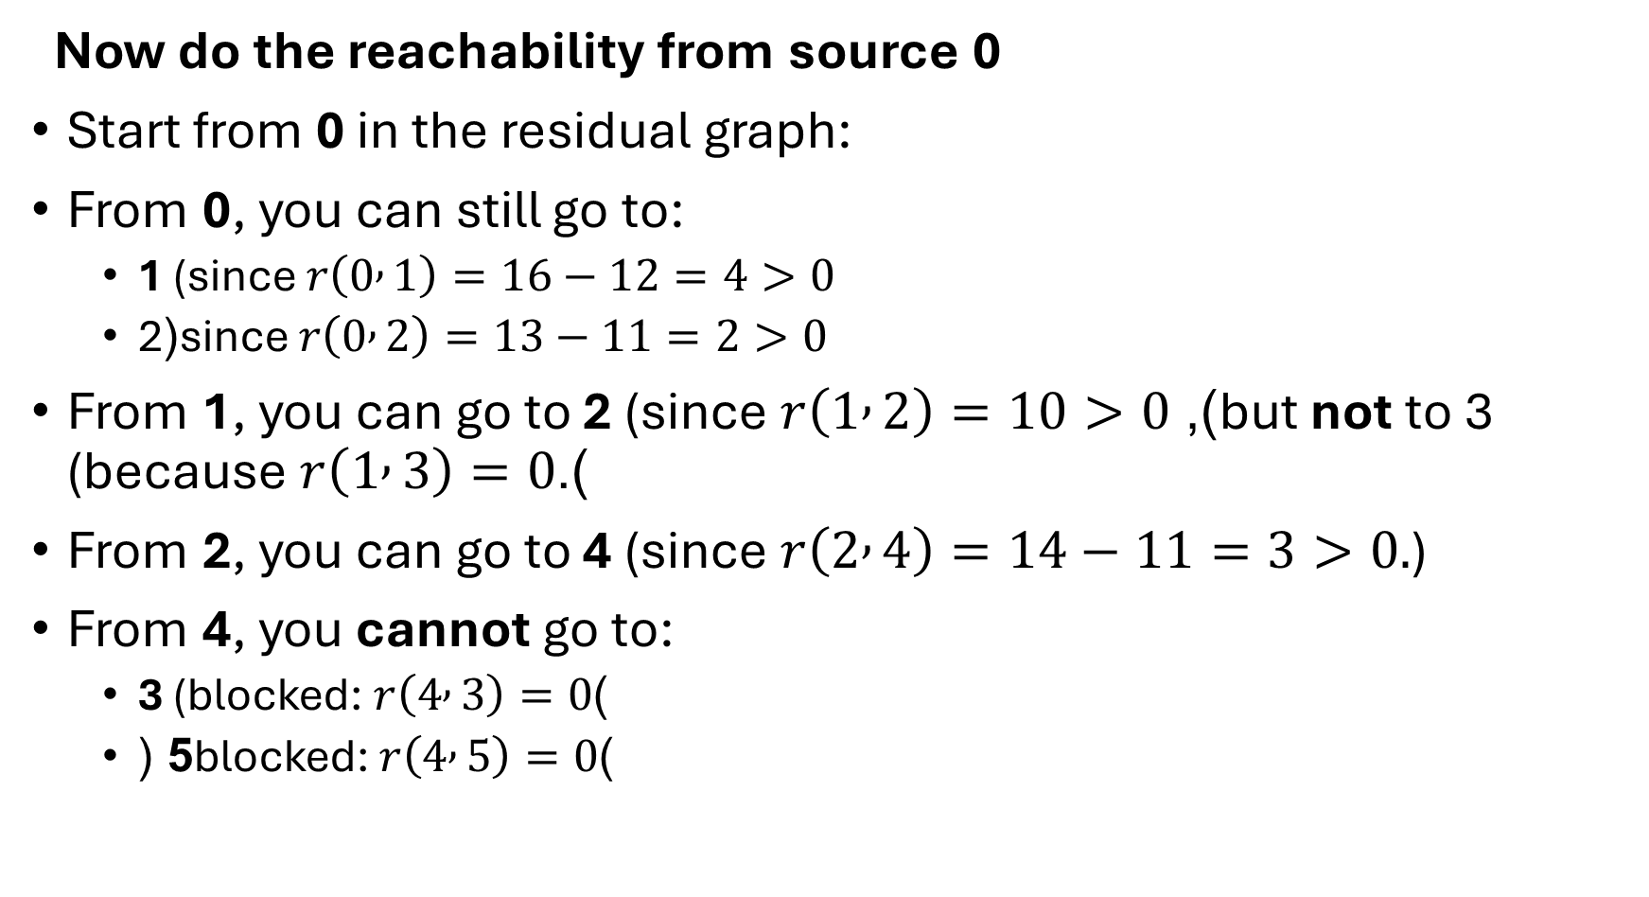
Now do the reachability from source 0
Start from 0 in the residual graph:
From 0, you can still go to:
1 (since $r\left(0 , 1\right)=16−12=4>0$
2(since $r\left(0 , 2\right)=13−11=2>0$
From 1, you can go to 2 (since $r\left(1 , 2\right)=10>0$), but not to 3 (because $r\left(1 , 3\right)=0$).
From 2, you can go to 4 (since $r\left(2 , 4\right)=14−11=3>0.$)
From 4, you cannot go to:
3 (blocked: $r\left(4 , 3\right)=0$)
5 (blocked: $r\left(4 , 5\right)=0$)

